Slide 1
M.Tech. C.S.
Linear Algebra

Slide 2
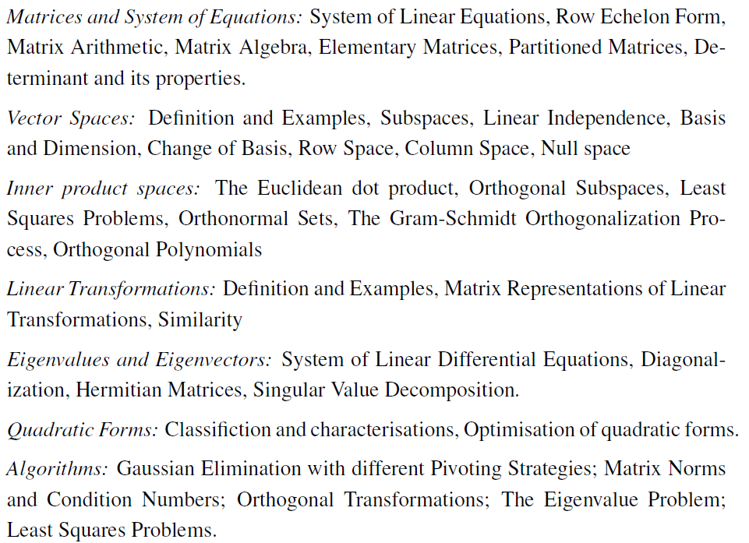
Syllabus

Slide 3
References:
Linear Algebra Done Right by Sheldon Axler, Springer
Linear Algebra with Applications by Steve Leon, Pearson Global edition.
Introduction to Linear Algebra by Gilbert Strang

Slide 4
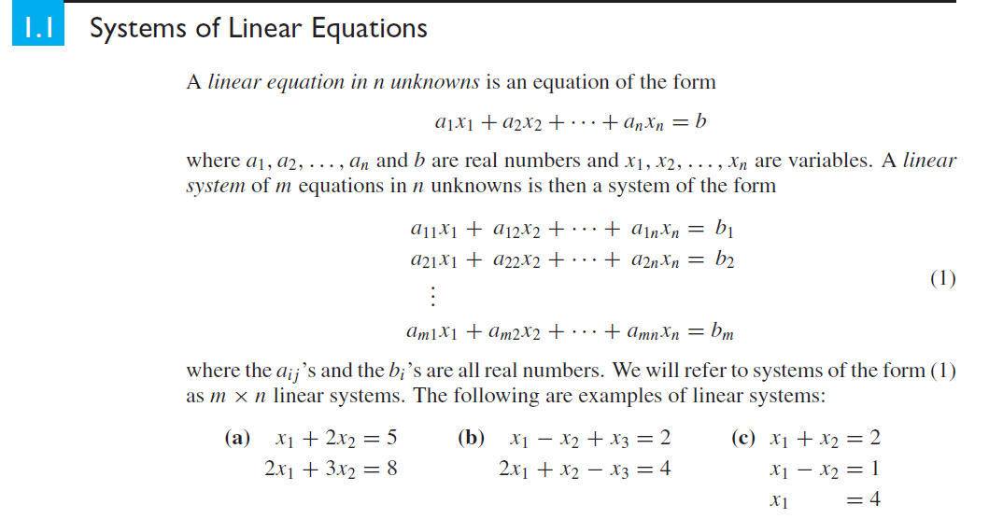

Slide 5
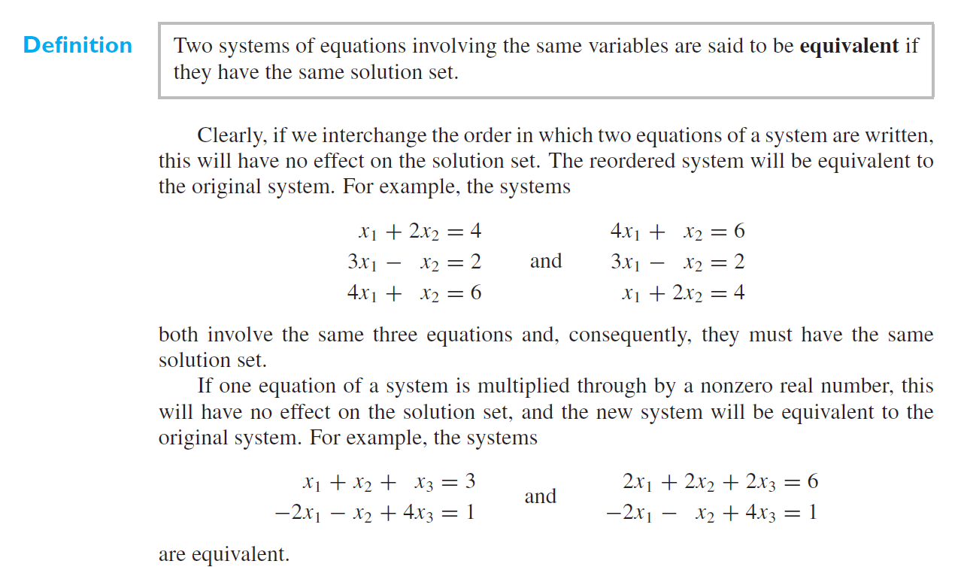

Slide 6
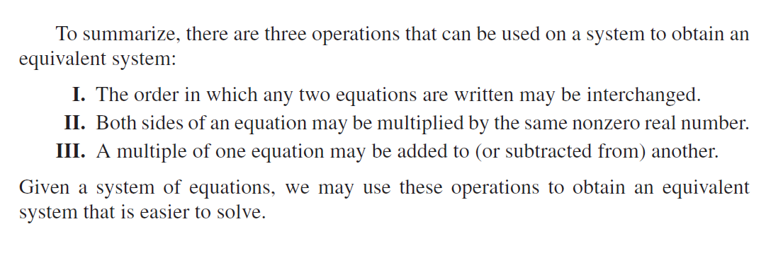

Slide 7
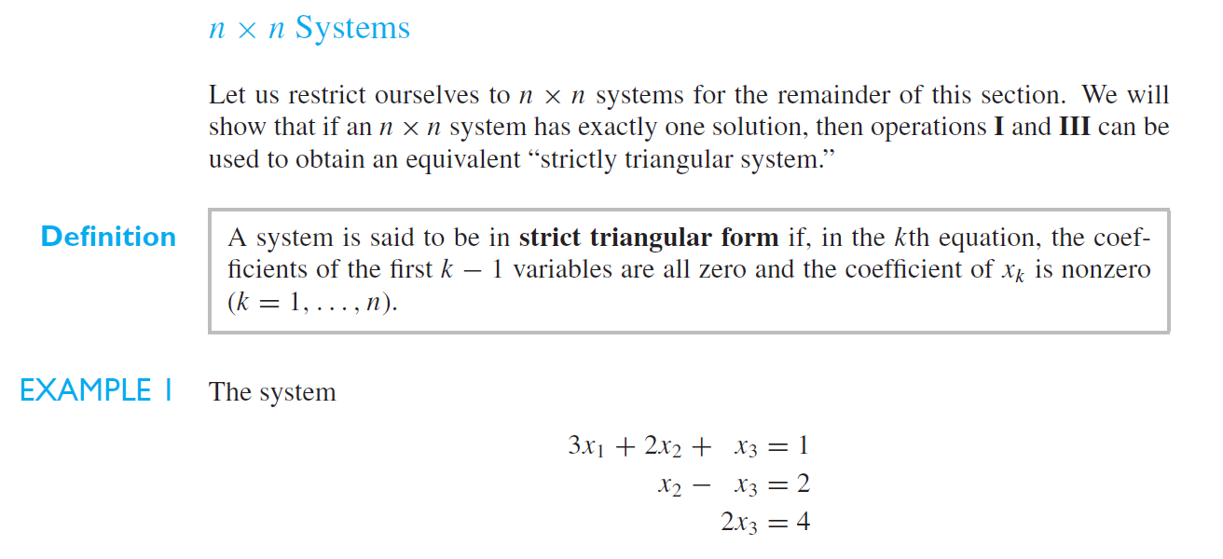

Slide 8
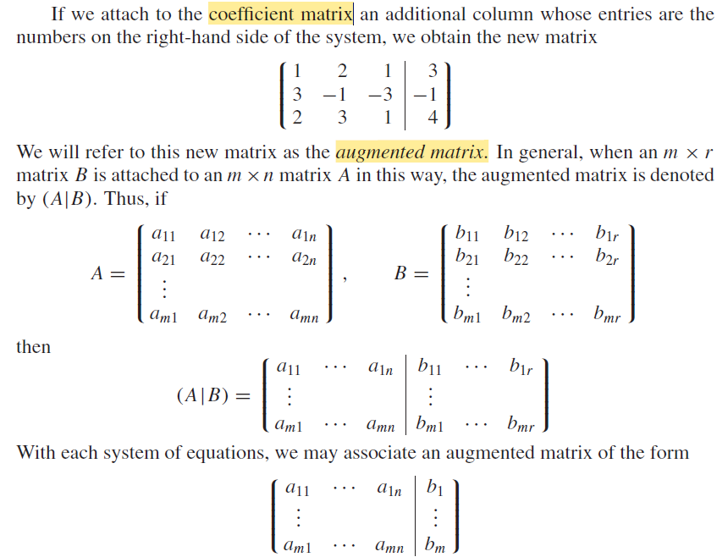

Slide 9
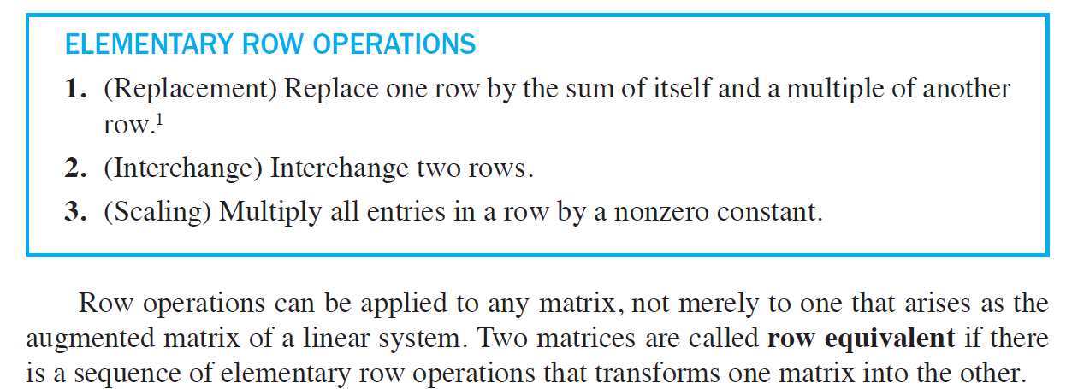

Slide 10
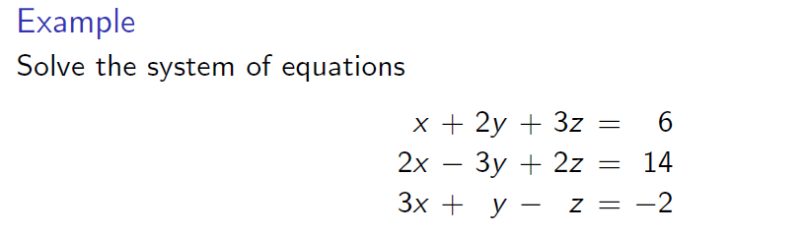
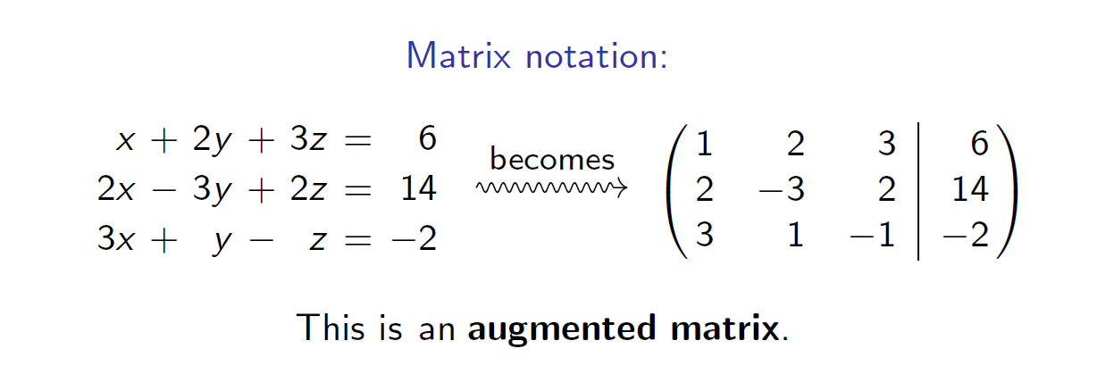

Slide 11
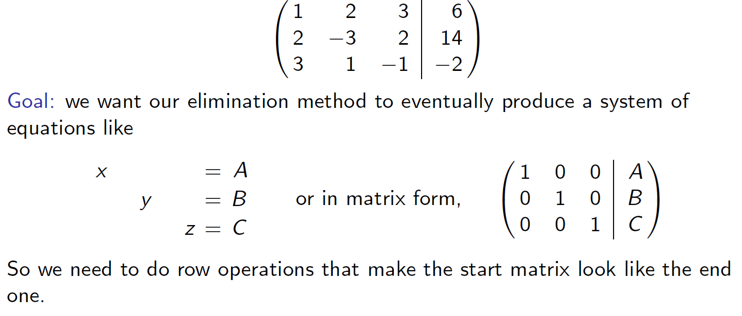

Slide 12

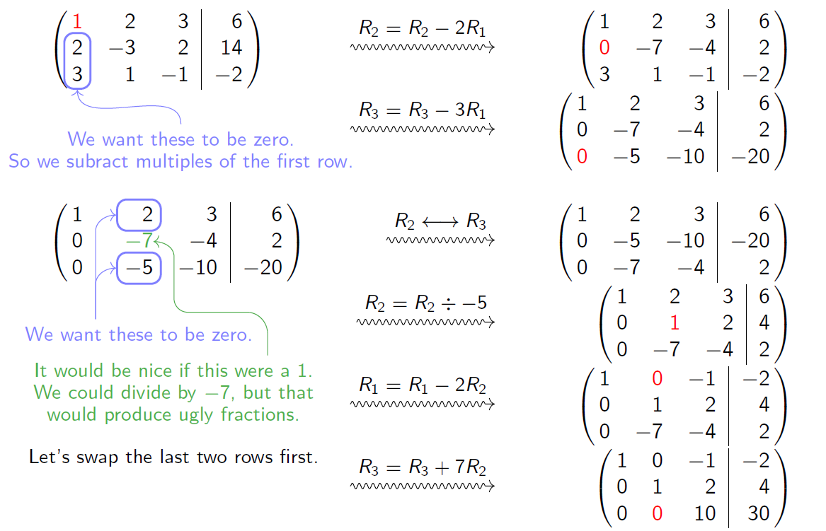

Slide 13
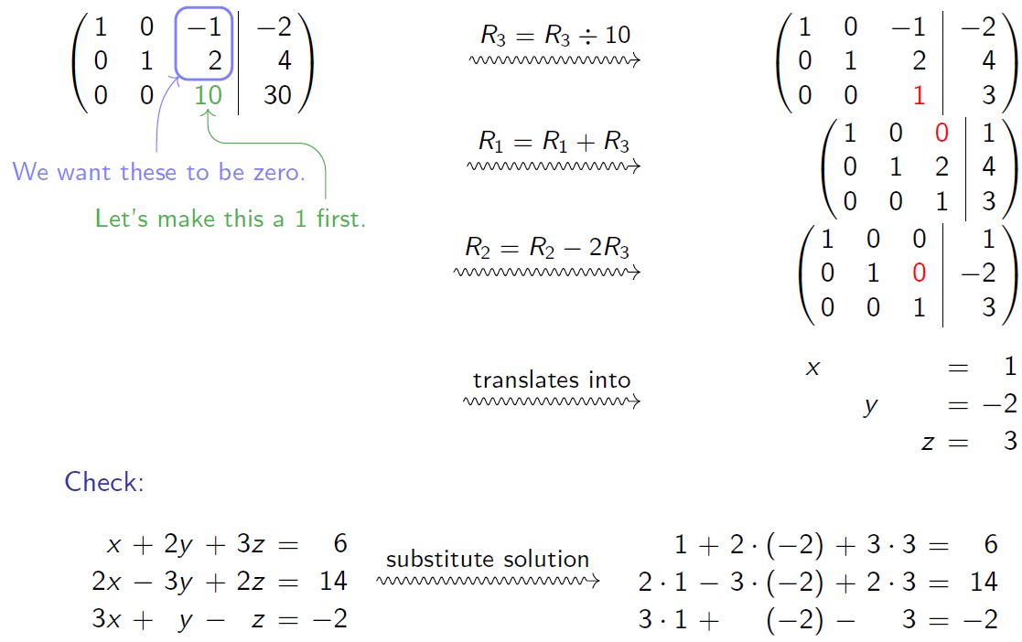

Slide 14
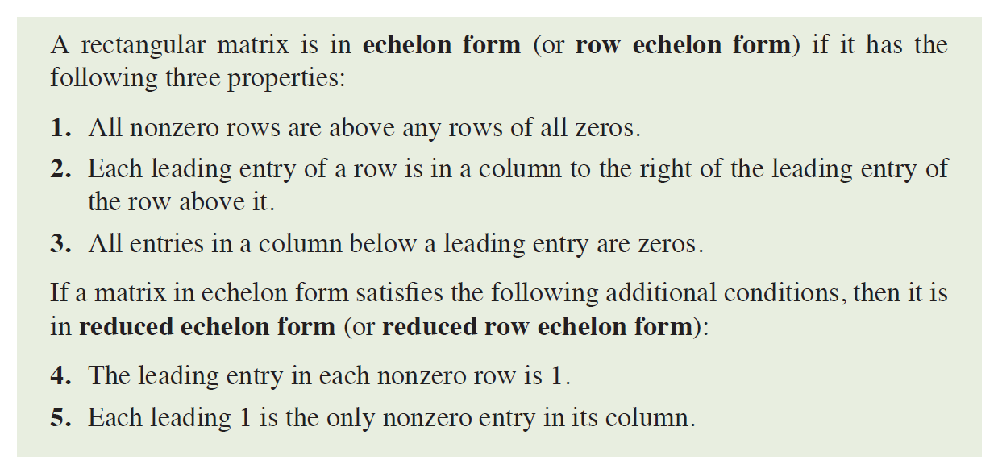

Slide 15
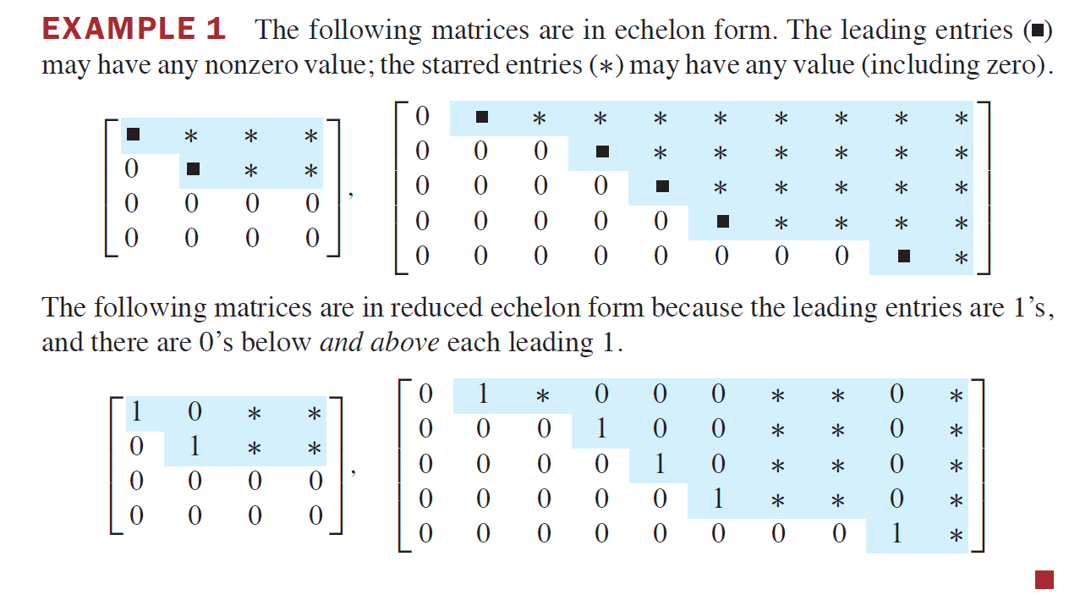

Slide 16
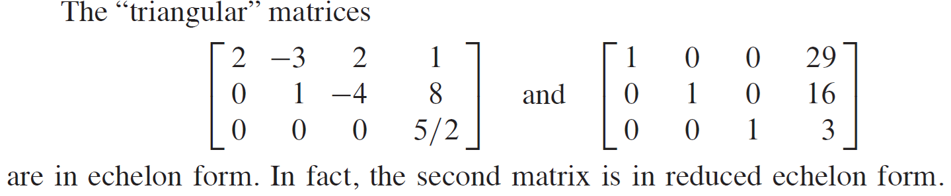
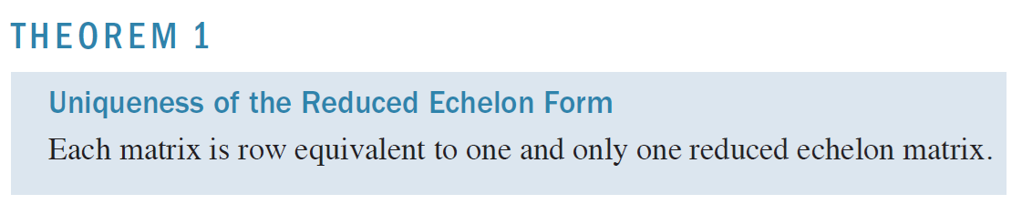
Proof.: Home task.

Slide 17
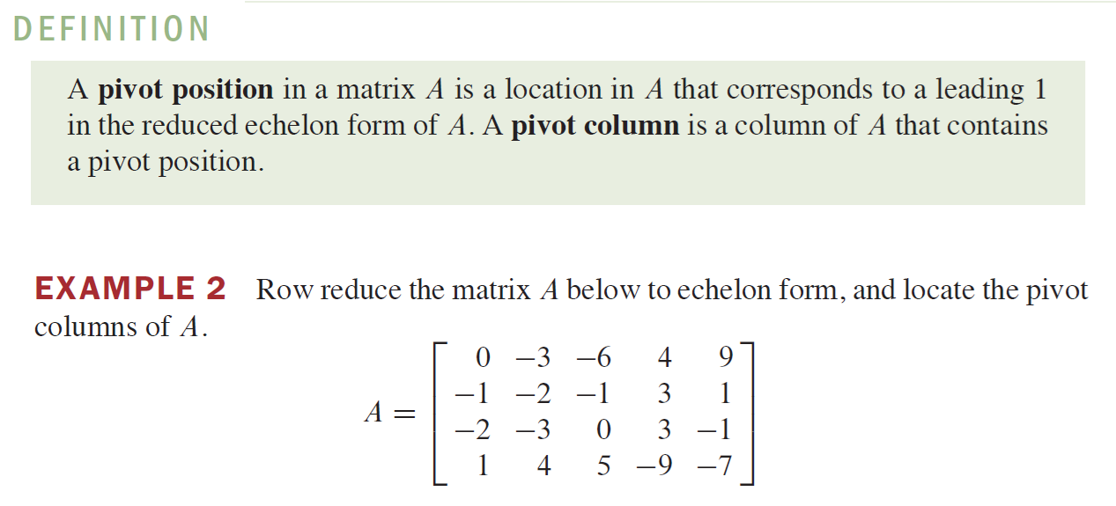

Slide 18
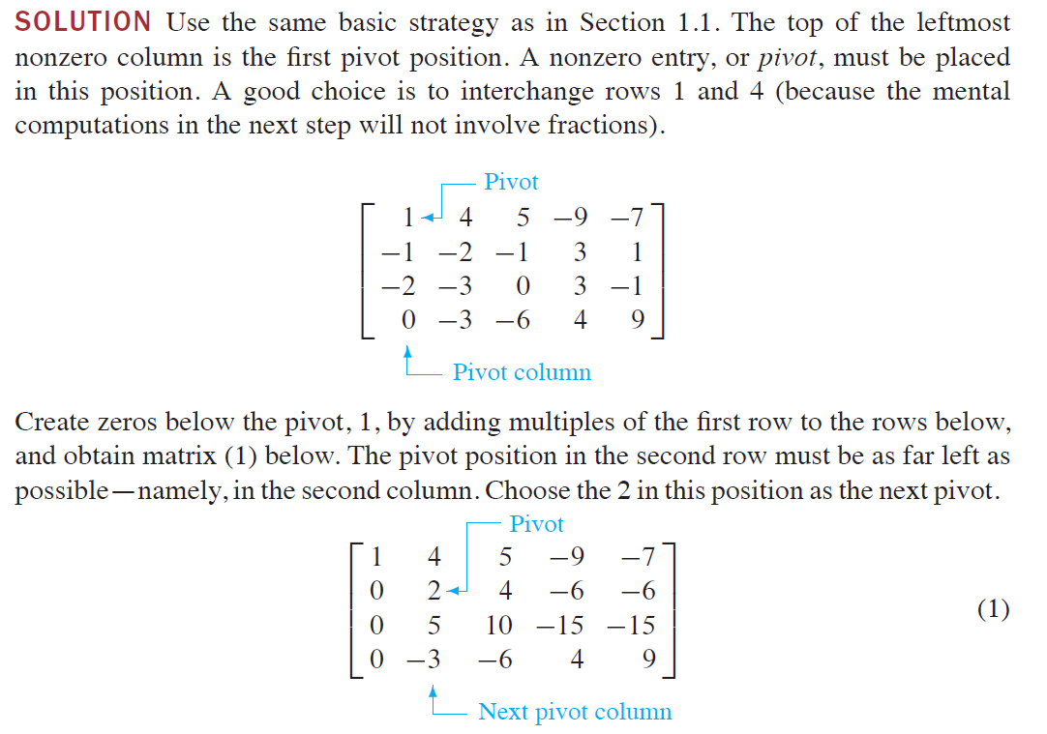

Slide 19
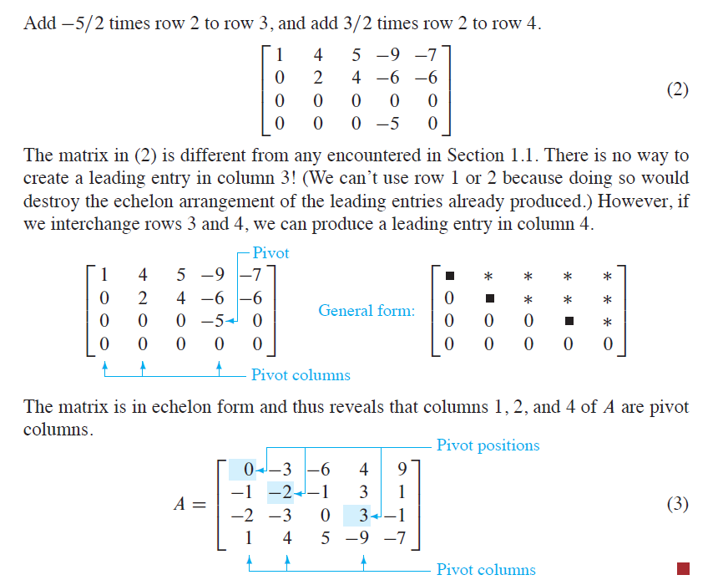

Slide 20
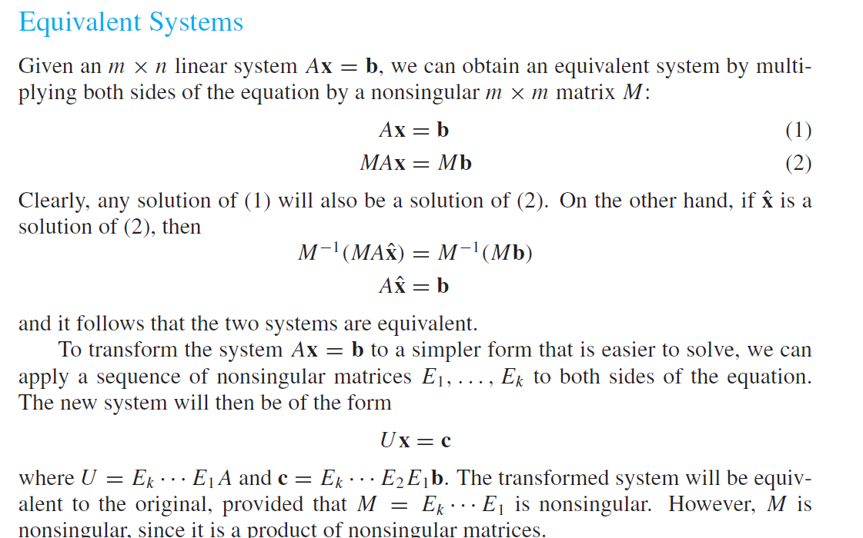

Slide 21
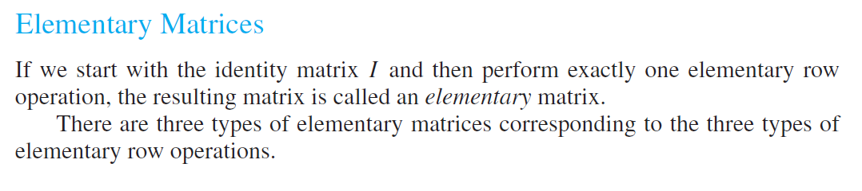
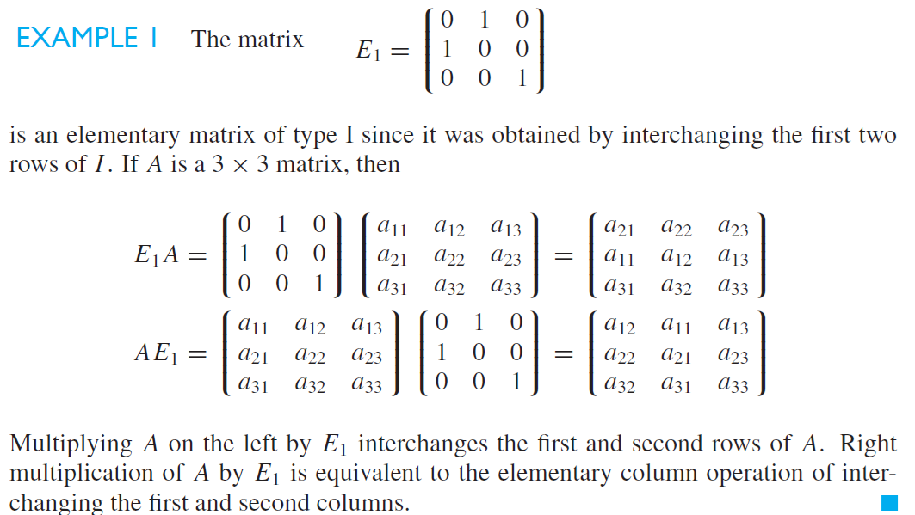

Slide 22
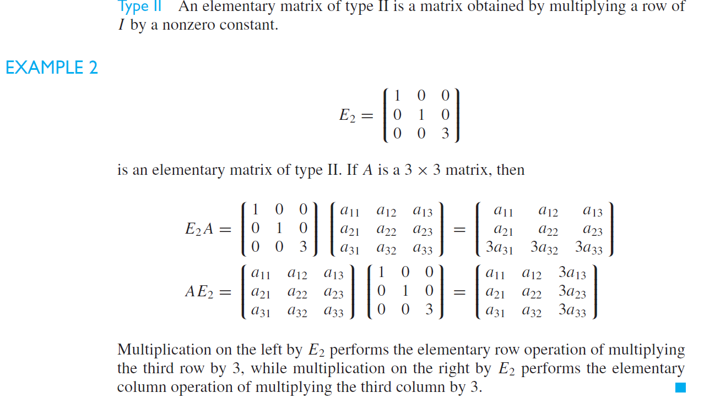

Slide 23
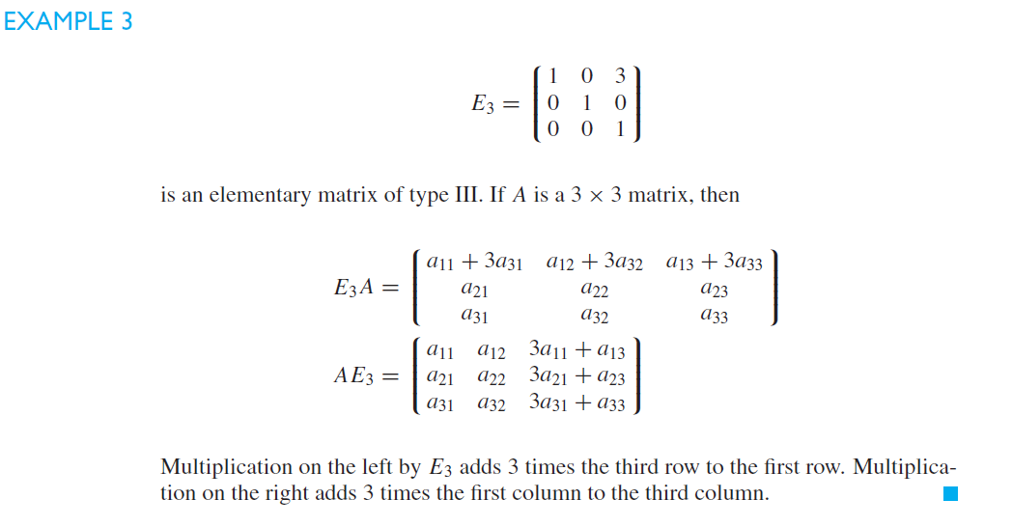

Slide 24
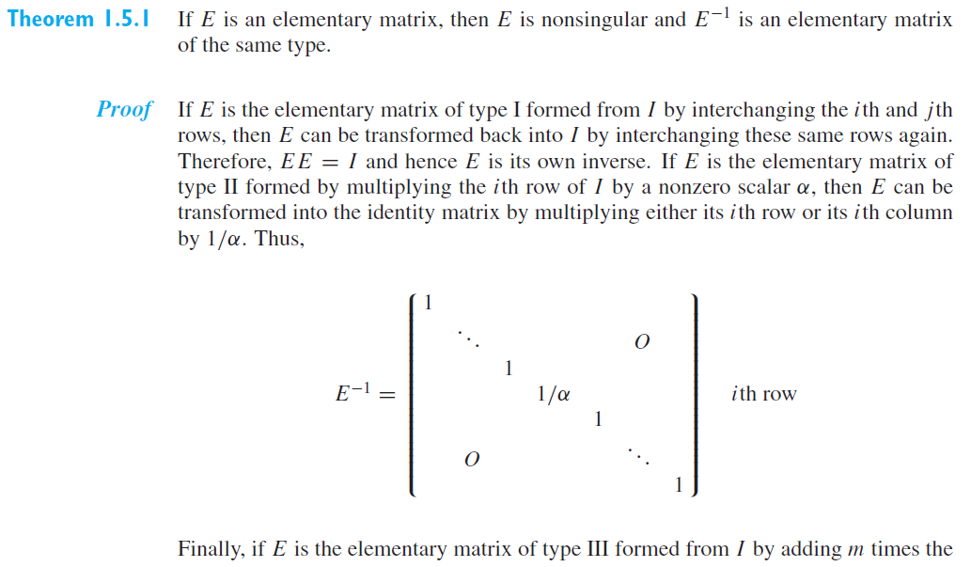

Slide 25
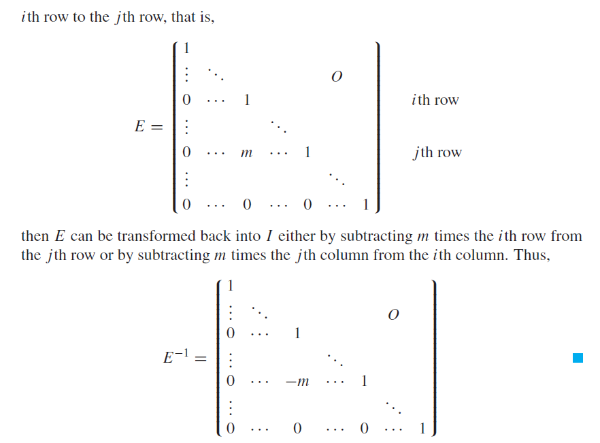

Slide 26
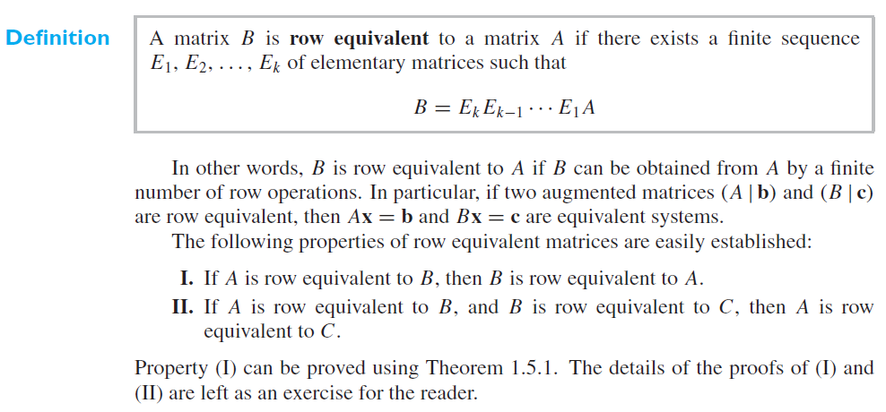

Slide 27
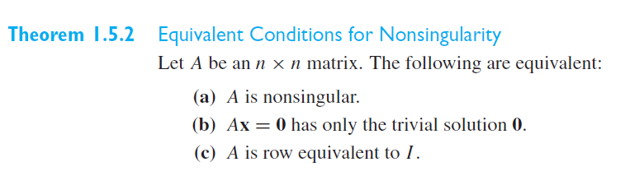
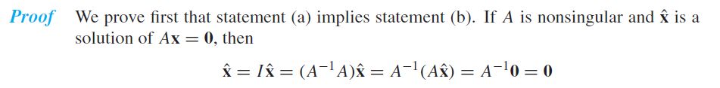

Slide 28
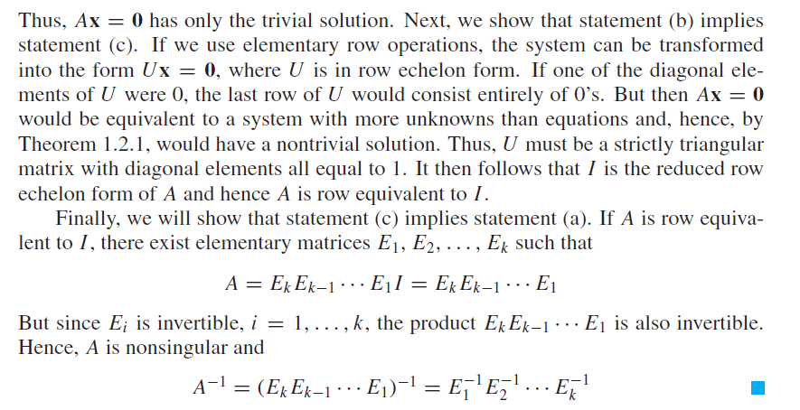

Slide 29
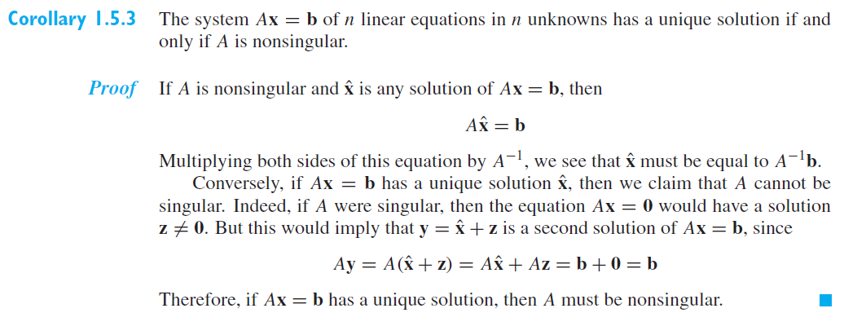

Slide 30
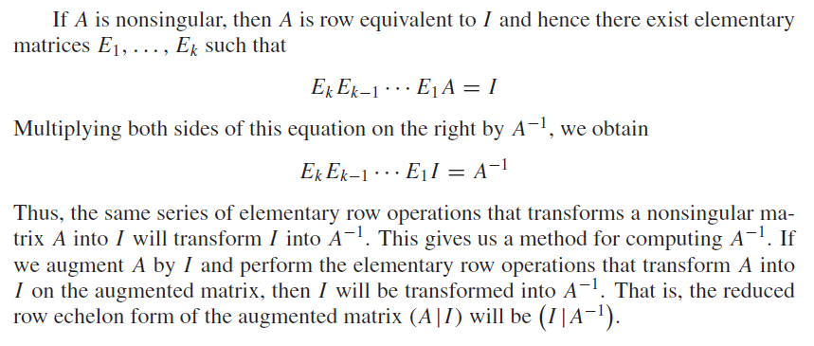

Slide 31
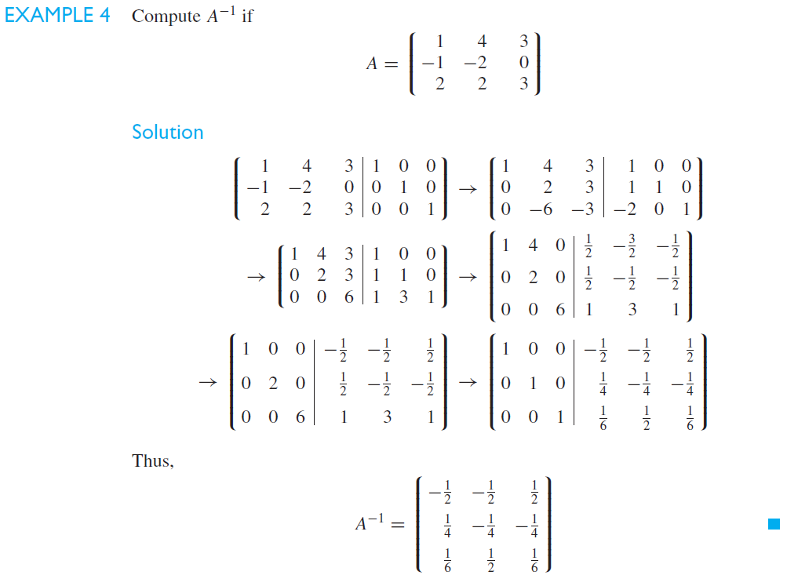

Slide 32
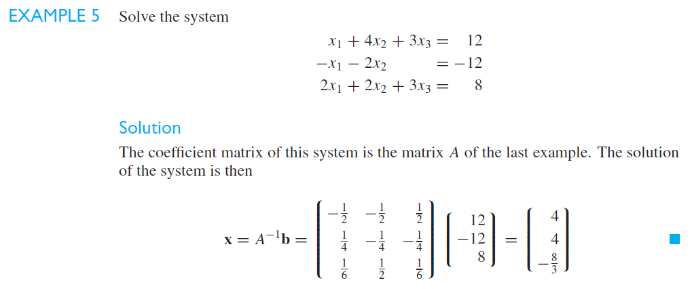

Slide 33
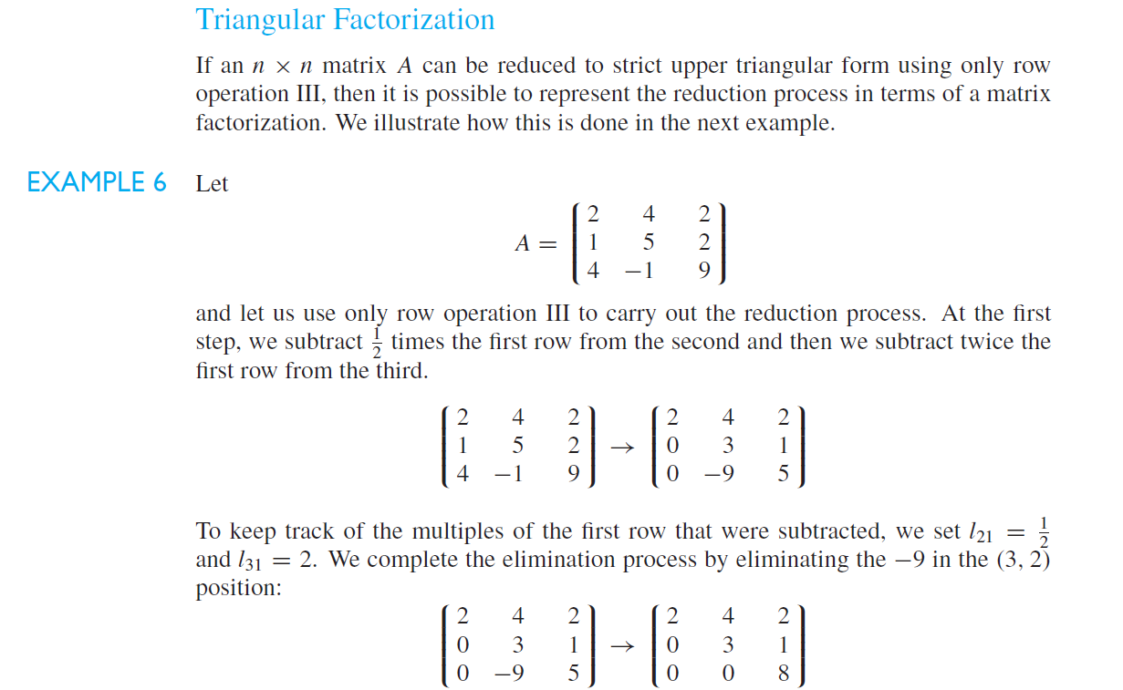

Slide 34
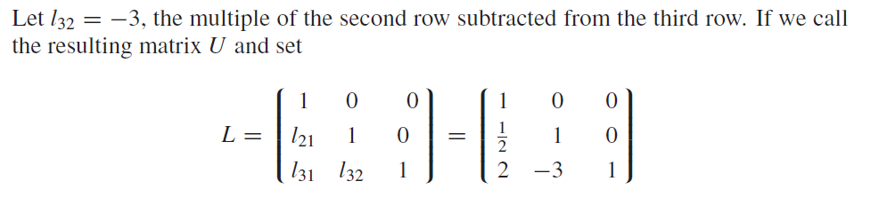
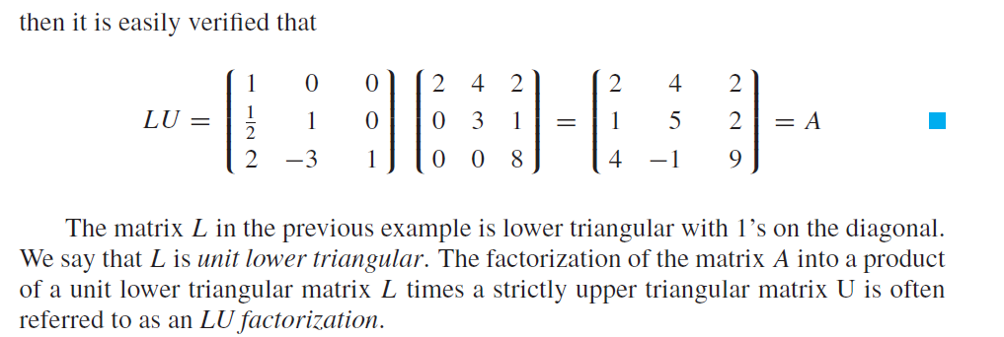

Slide 35
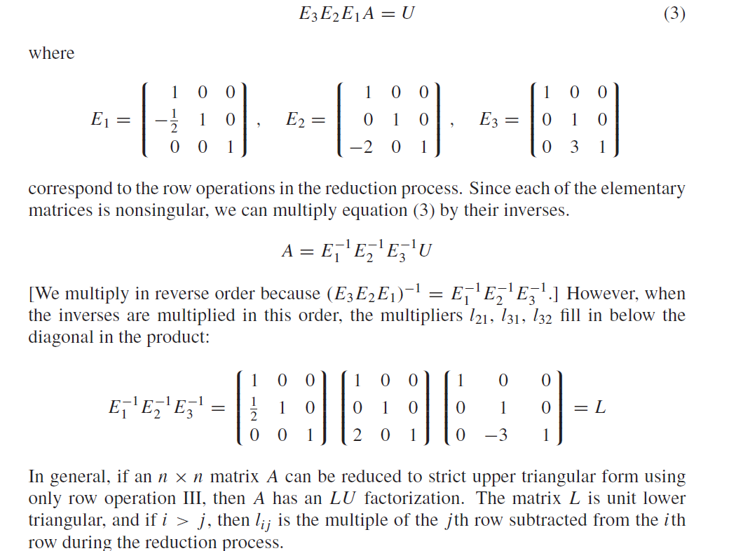

Slide 36
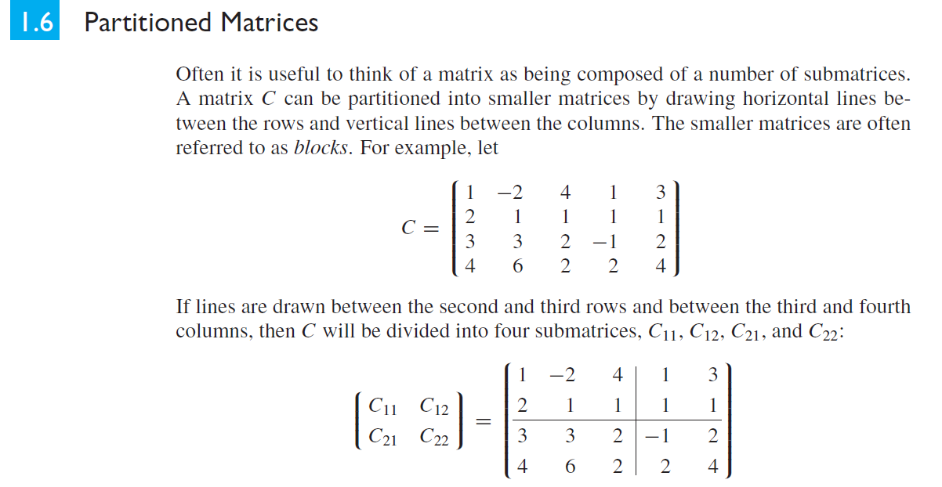

Slide 37
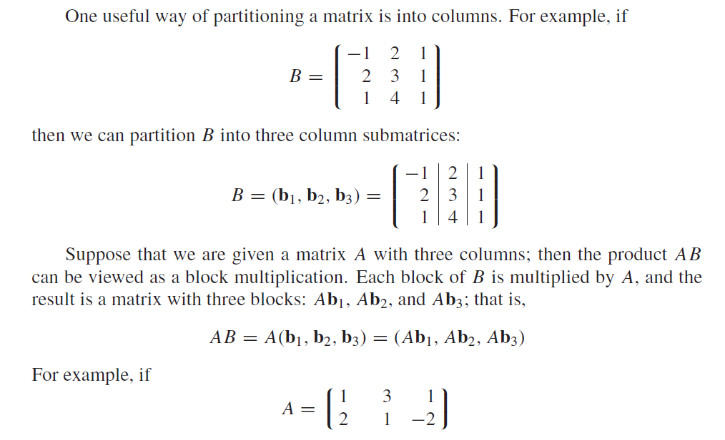

Slide 38
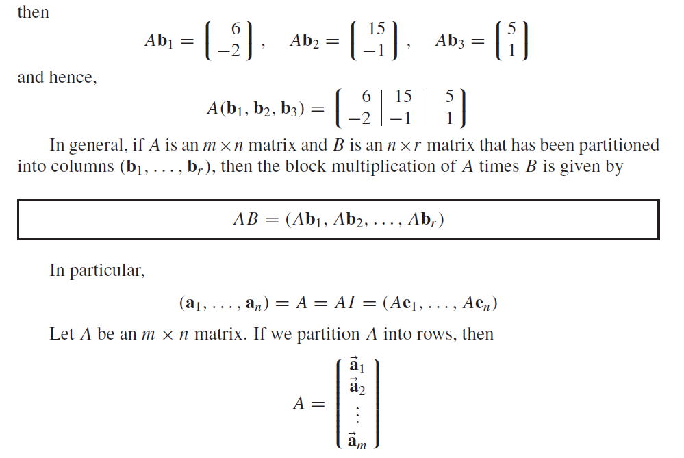

Slide 39
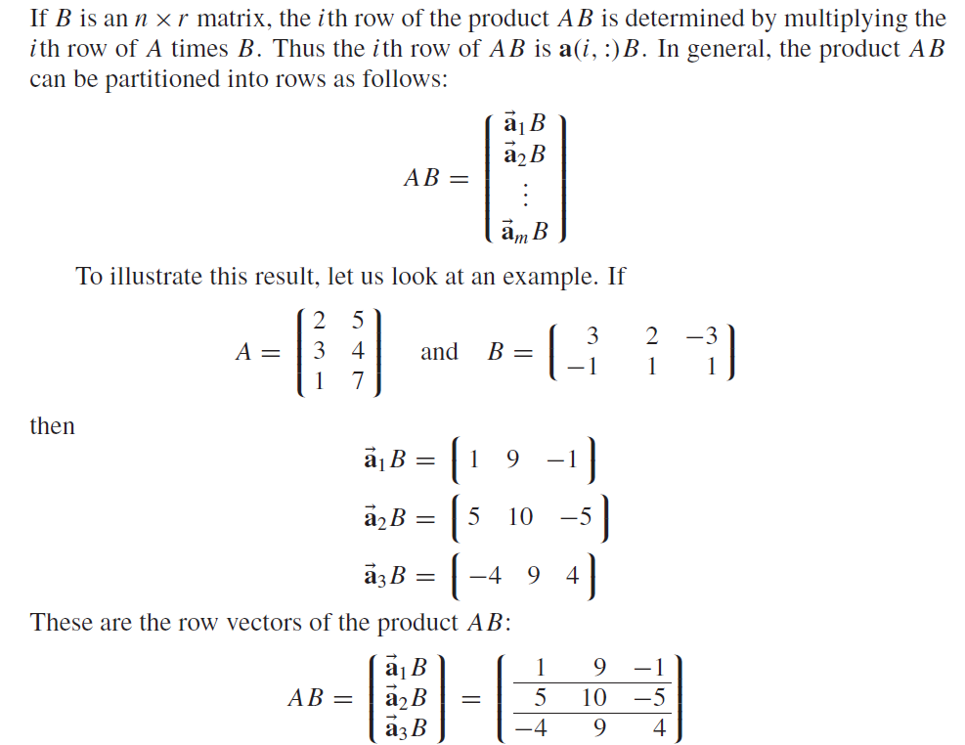

Slide 40
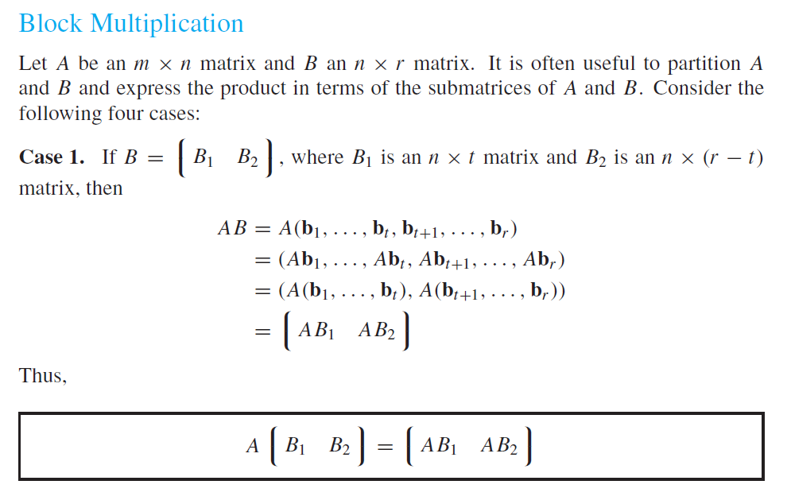

Slide 41
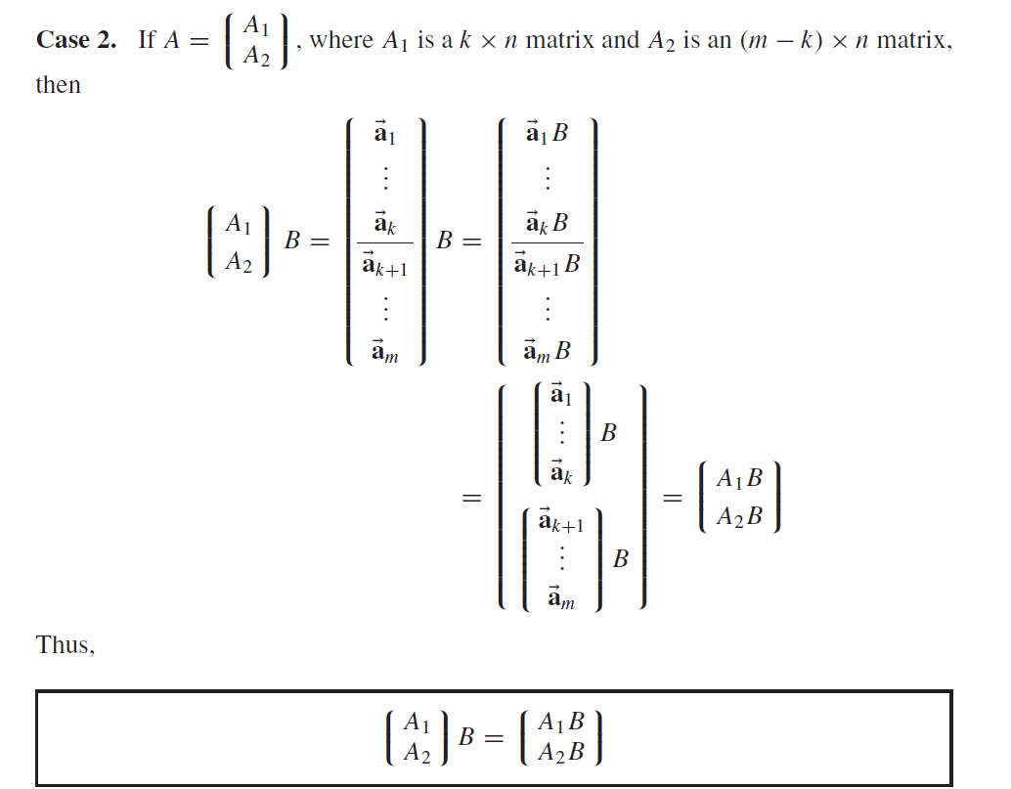

Slide 42
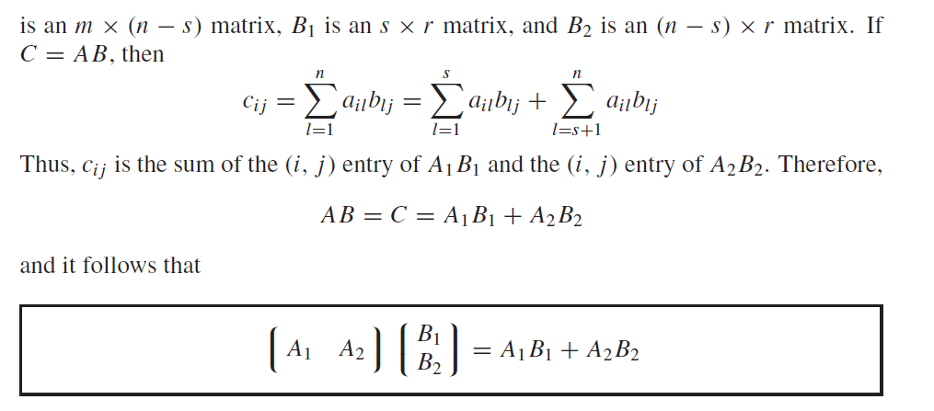

Slide 43
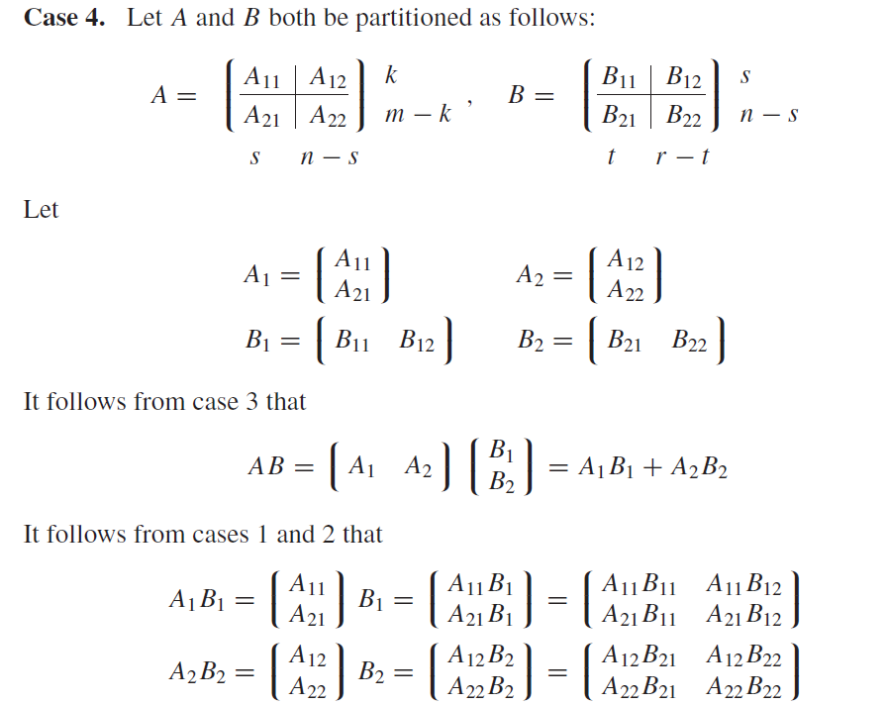

Slide 44
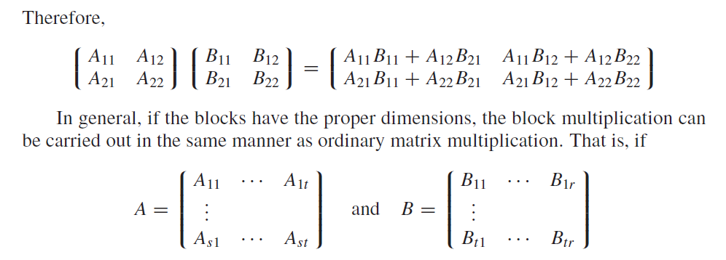

Slide 45
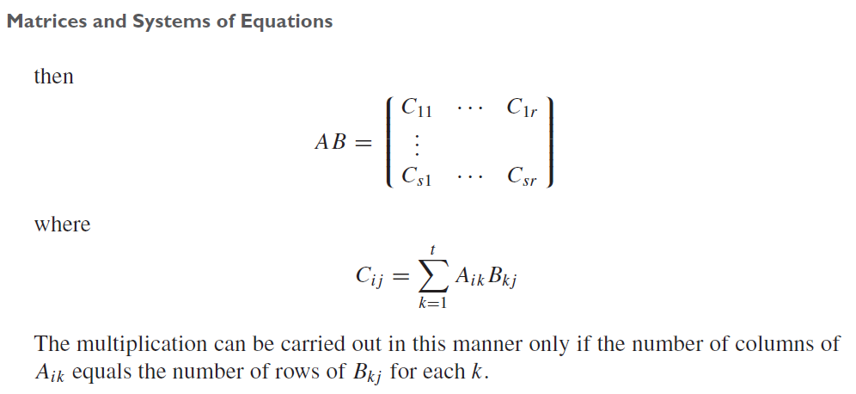

Slide 46
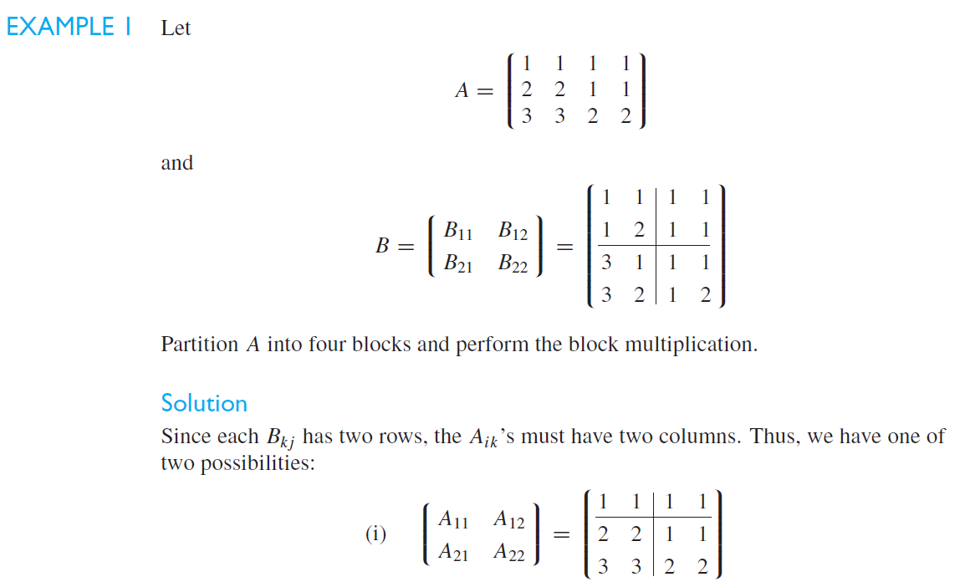

Slide 47
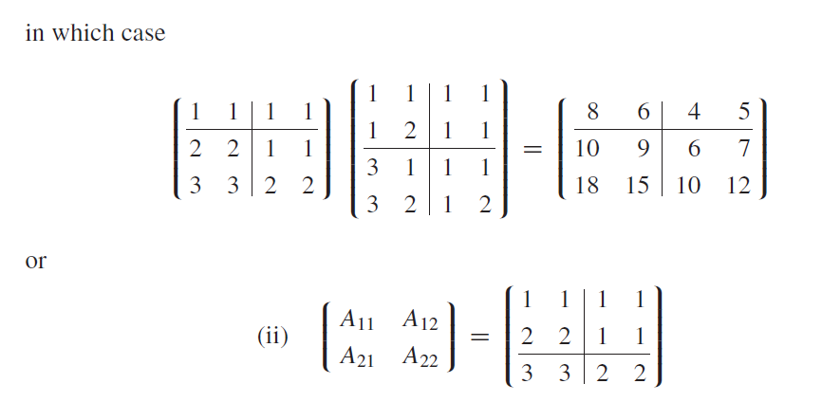


Slide 48


Slide 49


Slide 50


Slide 51



Slide 52



Slide 53


Slide 54
Do all the exercises of S. J. Leon Book Section 1.1 to 1.6

Slide 55



Slide 56

GROUP
**Ref. Book: Abstract Algebra by I. N. Herstein

Slide 57



Slide 58


Slide 59

Vector Space:
Note: The empty set is not a vector space.

Slide 60




Slide 61


Subspace

Slide 62


Slide 63


Slide 64


Slide 65


Slide 66


Remark: Set of all solutions on [a, b] of any n ordered linear homogeneous differential
equation forms a vector space which again a subspace of
$$C^{n}\left[a, b\right].$$

Slide 67


Slide 68



Slide 69







Slide 70



Slide 71






Slide 72


















Slide 73



Slide 74


Slide 75


Slide 76



Slide 77






Slide 78






Slide 79




Slide 80



Slide 81


Slide 82






Slide 83


Slide 84


Slide 85


Slide 86


Slide 87


Slide 88


Slide 89





Slide 90


Slide 91


Slide 92



Slide 93



Slide 94



Slide 95


Slide 96


Slide 97


Slide 98


Slide 99


Slide 100


Slide 101


Slide 102



Slide 103



Slide 104


Slide 105


Slide 106


